Slide 1
MCDA 5550 - Web App Development Chapter 8. Using servers for sharing and storing information
Instructor: Dinesh kg

Slide 2
Storing data on a server
Many mobile apps often need to access remote resources (DB, files, intensive scientific computing, gaming engines, etc.)
i.e., Mobile app developers need knowledge to deal with all these resources

Slide 3
Storing data on a server
Before…
Stored data using local Storage (i.e., write to and read from local storage space)
Data only accessible from the same device
Users can delete/modify if they wish

Slide 4
Storing data on a server
This time…
Store data on a remote server
Data accessible from any device from anywhere
Data can be modified by users only through your apps (users could “hack” their local storage data)

Slide 5
Server-/client-side scripting
Client-side scripts
Run on client’s browsers (i.e., JavaScript's we’ve seen so far)
Server-side scripts
Run on a server, responding to requests from their clients

Slide 6



Web server
Server-side scripting
Access server resources
Client-side scripting
Clients
Obtain data/response
Obtain web page with data

Slide 7
Server Hosting Technologies
Host OS
Windows, Unix-like (e.g., Linux)
Server-side (programming) languages
PHP
Perl
Python
Ruby
ColdFusion
JavaScript (e.g., Node.js)
JSP (Java)
ASP (VBScript etc.)
And more …

Slide 8
dev.cs.smu.ca
Running Linux host (Ubuntu 14.04)
We will use Node.js (JavaScript) for server-side scripting

Slide 9
Node.js
A platform/runtime environment, built on Chrome's (Google V8) JavaScript engine.
Open-Source
Cross-platform: Mac OS X, Windows and Linux
Can provide a web server (and other services)

Slide 10
Know your way around in Linux
In order to write and run server-side scripts, you’ll need to be able to execute various operations
e.g.)
Create/delete/copy files/folders
Browse and list files/folders
Run scripts
Manipulate running processes (view and kill)

Slide 11
Secure shell access
So far, we have used WinSCP (and similar) to “transfer” files. (using sftp, scp, pscp)
We now access it using ssh (Secure Shell) protocol
Native support in Linux/Mac. (in terminals)
Windows supports ssh now. (Command Prompt, PowerShell, Ubuntu for windows)

Slide 12
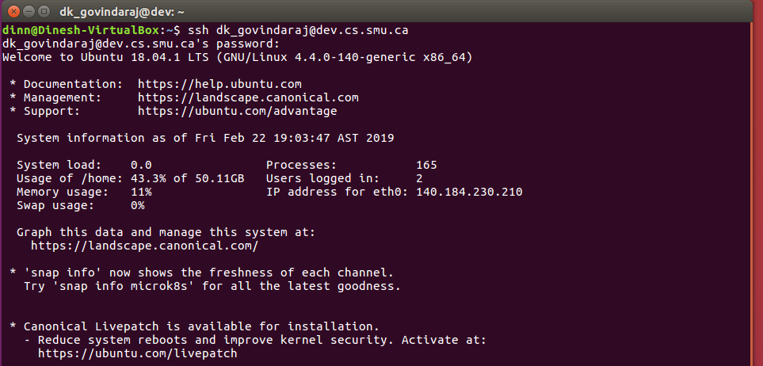
ssh programs on Linux/Mac
On Linux or Mac, use the terminal and run:
ssh user_id@dev.cs.smu.ca

Slide 13
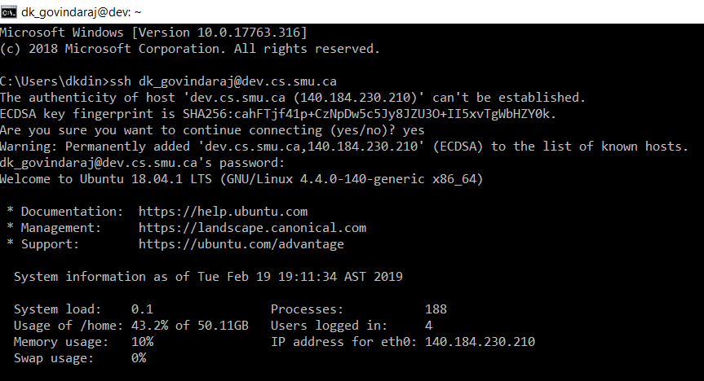
ssh on Windows
Open the command prompt and run:
ssh user_id@dev.cs.smu.ca

Slide 14
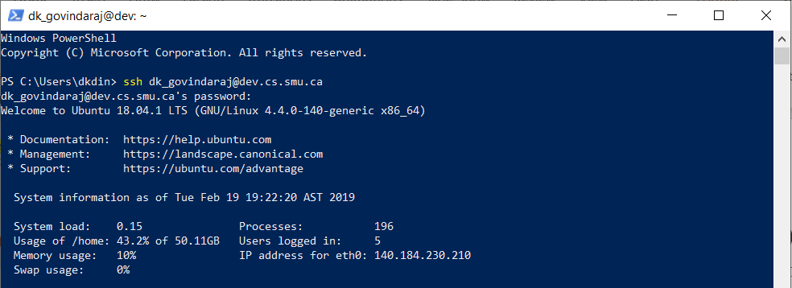
ssh on Windows
Open the power shell and run:
ssh user_id@dev.cs.smu.ca

Slide 15
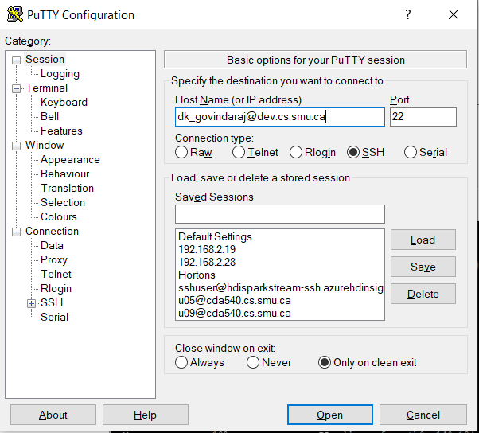
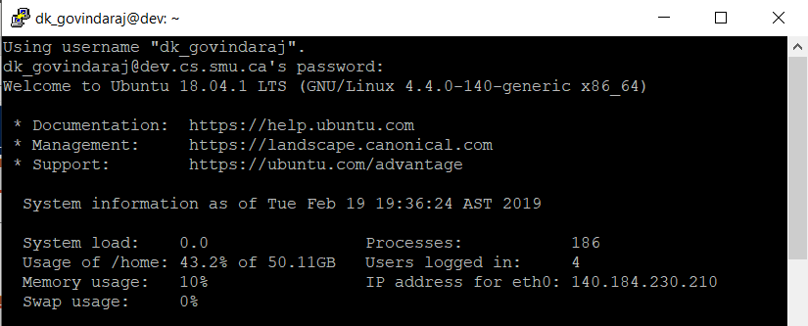
ssh on Windows (Putty)
Download and Open Putty and run:
ssh user_id@dev.cs.smu.ca

Slide 16
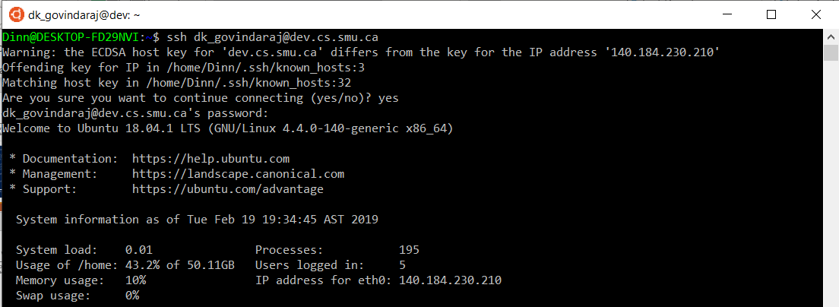
ssh on Windows (Ubuntu)
Download, Open Ubuntu and run:(remember it’s just Linux interface) https://tutorials.ubuntu.com/tutorial/tutorial-ubuntu-on-windows#0
ssh user_id@dev.cs.smu.ca

Slide 17
Basic Linux commands
ls list files/folders
Commonly used options, l (long listing), S (Sort by size), t (sort by time), r (reverse order), h (human readable size), d (shows only directory) many more!
Use hyphen (-) to specify options
E.g.)
ls -ltrh
Long-listing, sort by time (in reverse order), use human readable size
ls -d */
Only list directories in the current directory

Slide 18
Basic Linux commands
cd change directory
pwd display current directory
mkdir create a new directory
mv move files/directories (Often used to rename the file as well)
cp copy files/directories
rm delete files
rmdir delete directories
clear clear the screen

Slide 19
Basic Linux commands
touch create a new empty file
cat display file content
head display only the beginning
tail display only the end
more display long content by page
less like more but can go backward
grep display lines containing strings

Slide 20
Basic Linux commands
top display system processes
ps snapshot of current processes
kill kills process by id
killall kill all processes by name
man manual of commands
| “pipe” (not really a “command”)
& run command in background
> redirection (overwrite)
>> redirection (append)

Slide 21
Basic Linux commands
screen
open several separate terminal instances inside one single terminal window manager.
Useful when running and monitoring multiple processes
e.g., when running a few Node.js processes
ctrl+A followed by ctrl+D to detach the screen
screen –r to reattach detached screens

Slide 22
app-server.js
var express = require('express');
var server = express();
server.use('/scripts', express.static(__dirname + '/scripts'));
server.use('/css', express.static(__dirname + '/css'));
server.use(express.static(__dirname));
server.listen(9898);
Server-side script
Need to run on a server
lsof -i tcp:XXXX – Check active nodes on your port (XXXX is your port. Notice PID.)
kill -9 PID (PID – service number of active nodes)

Slide 23
app-server.js
require() function loads a module
Synonymous to import (Java, Python), include (C++/PHP)
var server = express();
Creates a new express server object
use() function specifies an alias path
__dirname is a variable representing the current directory
Could redirect to your home directory etc.
listen() function starts the server with a specified port
You are assigned specific ports (Do not use other’s port)

Slide 24
Network ports
An (logical) endpoint of communication
Each IP address can have multiple ports, each of which is assigned for a process or a type of service

Slide 25
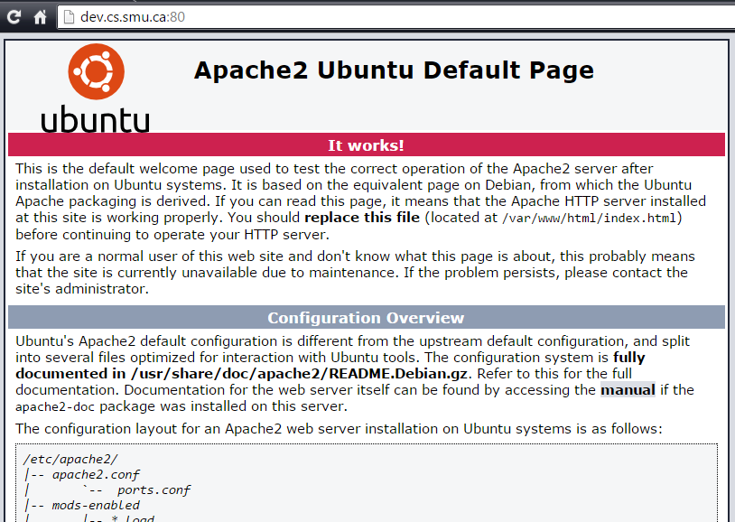
Network ports
e.g.)
80 is typically used for HTTP services, and we’ve been using it implicitly:
http://dev.cs.smu.ca:80

Slide 26
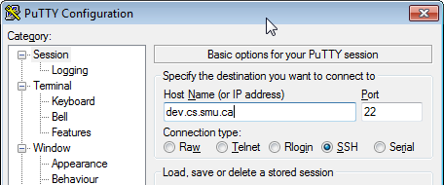
Network ports
e.g.)
22 is typically used for SSH
You will be assigned 2 unused ports, so as not to overlap with others!!
Don’t block somebody else’s port (using it in your code)!!
If you do, then you’ll be penalized on your assignments, even by accident!!

Slide 27
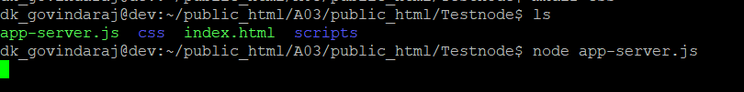
Running node.js scripts
Logon to dev.cs.smu.ca using ssh
cd to the directory where you saved the script file
Type “node” followed by a space and the name of the script file

Slide 28
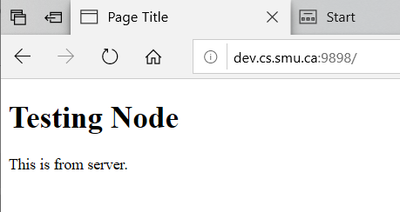
Now open in browser
dev.cs.smu.ca:nnnn
Where nnnn is the port number used in app-server.js
index.html needs to be in the same folder as app-server.js

Slide 29
Your Port #
Ahuja, Bhavya A00428499, b_ahuja , 8100 and 8101
Al Achkar, Simon A00425630, s_alachkar, 8102 and 8103
Bandyopadhyay, Parijat A00430847, p_bandyopadhyay, 8104 and 8105
Baria, Maninder Kaur A00429943, mk_baria, 8106 and 8107
Boopathy, Vivekanand A00425792, v_boopathy, 8108 and 8109
Cai, Qian A00428662, q_cai, 8110 and 8111
Channaveerabhadraiah,Su A00428901, sk_channaveerabhadraiah, 8112 and 8113
Fasuyi, Morounkeji O. A00421483, m_fasuyi, 8114 and 8115
Govindan, Vinay A00429120, v_govindan, 8116 and 8117
Gupta, Rishab A00429019, r_gupta, 8118 and 8119
Hussain, Mohd A00428036, mn_hussain, 8120 and 8121
Irfanoglu, Caner Adil A00425840 , ca_irfanoglu, 8122 and 8123
Kour, Jasleen A00425843, j_kour, 8124 and 8125
Kovvuri, Sri A00428260, sa_kovvuri, 8126 and 8127
Leong, Madeleine Min Jing A00430926, mm_leong, 8128 and 8129
Magray, Shahzan A00427266, s_magray, 8130 and 8131
Murugappan, Kothai Kannappan A00427876, kk_murugappan, 8132 and 8133
Nomula, Rahul A00427267, r_nomula, 8134 and 8135
Oberoi, Ravneet Singh A00426623, rs_oberoi, 8136 and 8137
Padikar M, Sunil A00428089, s_padikar, 8138 and 8139
Punnoli, Sreeraj A00429404, s_punnoli, 8140 and 8141
Sadi, Sadman Hoque A00426020, sh_sadi, 8142 and 8143
Sambhwani, Diven Kumar A00425915, dk_sambhwani, 8144 and 8145
Sharma, Aman A00429273, a_sharma, 8146 and 8147
Shree, Bhagya A00431152, b_shree, 8148 and 8149
Singh, Gaganpreet A00429660, g_singh, 8150 and 8151
Sivaraman, Ashwin A00426488, a_sivaraman, 8152 and 8153
Thapa Magar, Sarbottam A00430095, s_thapamagar, 8154 and 8155
Verma, Bharat Bhushan A00431571, bb_verma, 8156 and 8157
Wang, Jingshu A00428778, j_wang, 8158 and 8159
Yan, Zewei A00429842, z_yan, 8160 and 8161
Test Ports : 8165 to 8175 (only in case of port blocks)

Slide 30
get
A request method (supported by the HTTP protocol)
Requests for data from the server
GET should only retrieve data and should have no other effect.

Slide 31
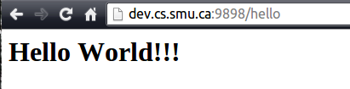
Cont’d…
//server-side
app.get('/hello', function (request, response) {
return response.send(200, '<h1>Hello World!!!</h1>');
});

Slide 32
jQuery .get function
Syntax:
$.get( url, [dataToServer,] [function(data) {
// code when succeeded
// data can contain the returned data from server
}])
.fail(function() {
// code when succeeded
});

Slide 33
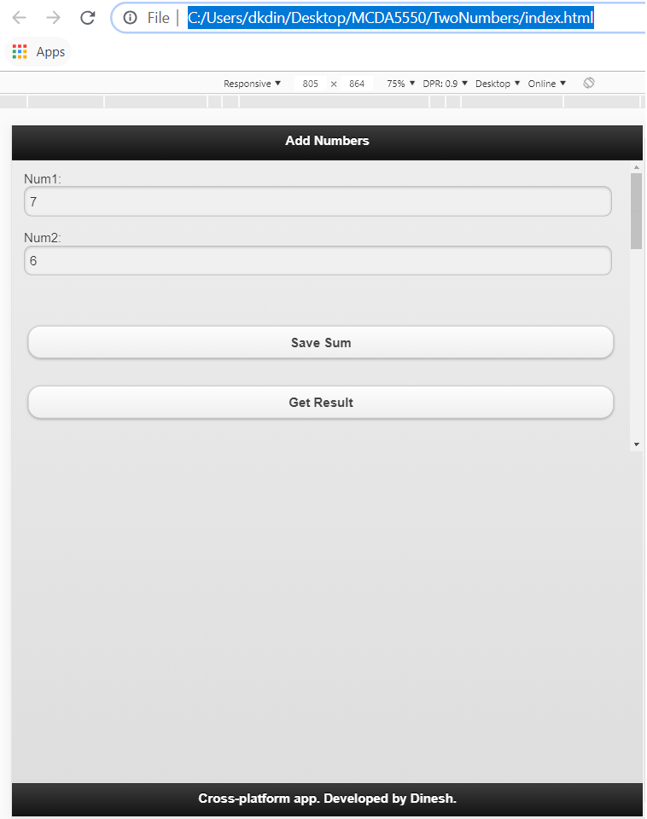
Activity
Create an app that has the UI below, and runs on the express server (using your assigned port number!!)
i.e.,
you shouldn’t need to
type the user URL
(only the port #)

Slide 34
Accessing server resources
Perform computation
Read from and write to a file (for now)
(and we’ll access databases later)

Slide 35
Activity
Add a client script to grab values from the input fields when the save button is clicked
Send a request to the server to “addNumbers” with the values obtained from the input fields.
Add a server side script to
receive the request (with the data)
perform addition
print the result to the server console

Slide 36
Client code
var SERVER_URL = 'http://dev.cs.smu.ca:9898';
function saveNumbers() {
var obj = {
"num1": $("#num1").val(),
"num2": $("#num2").val(),
"fileName": "result.txt"
};
//now send the request
$.post(SERVER_URL + "/addNumbers",
obj,
function (data) {
alert("Result saved successfully!");
}).fail(function (error) {
alert("Error: " +error.responseText);
});
}//end function

Slide 37
post
A request method (supported by the HTTP protocol)
Requests that a web server accepts and stores the data enclosed in the body of the request message.
Often used when uploading a file or submitting a completed web form.

Slide 38
jQuery .post function
Syntax:
$.post( url, dataToUpload, function(data) {
// code when succeeded
// data can contain the returned data from server
})
.fail(function() {
// code when succeeded
});

Slide 39
Cont’d…
//now store it
$.post(SERVER_URL + "/addNumbers",
obj,
function (data) {
alert("Result saved successfully!");
}).fail(function (error) {
alert("Error: " +error.responseText);
});

Slide 40
Server-side
const SERVER_PORT = 9898;
var express = require('express');
var fs = require('fs');
const FILE_NAME = "result.txt";
//CORS Middleware, causes Express to allow Cross-Origin Requests
// Do NOT change anything here
var allowCrossDomain = function (req, res, next) {
res.header('Access-Control-Allow-Origin', '*');
res.header('Access-Control-Allow-Methods','GET,PUT,POST,DELETE');
res.header('Access-Control-Allow-Headers','Content-Type');
next();
};
//set up the server variables
var app = express();
app.use(express.bodyParser());
app.use(allowCrossDomain);
app.use('/scripts', express.static(__dirname + '/scripts'));
app.use('/css', express.static(__dirname + '/css'));
app.use(express.static(__dirname));
//now start the application server
var server = app.listen(SERVER_PORT, function () {
console.log('Listening on port %d',
server.address().port);
});

Slide 41
Cont’d…
app.post('/addNumbers', function (request, response) {
console.log("Process being executed in " + __dirname);
//extract the data
var num1 = parseFloat(request.body.num1);
var num2 = parseFloat(request.body.num2);
console.log('Adding numbers: ' + num1 + " + " + num2);
var sum = num1 + num2;
console.log('Sum is : ' + sum);
});

Slide 42
(Brief) differences of get/post
Both methods can achieve the same goals!
Use GET for risk free actions and POST for risky actions.
GET requests can be cached, remain in browser history, bookmarked, etc
Use POST when dealing with sensitive data.

Slide 43
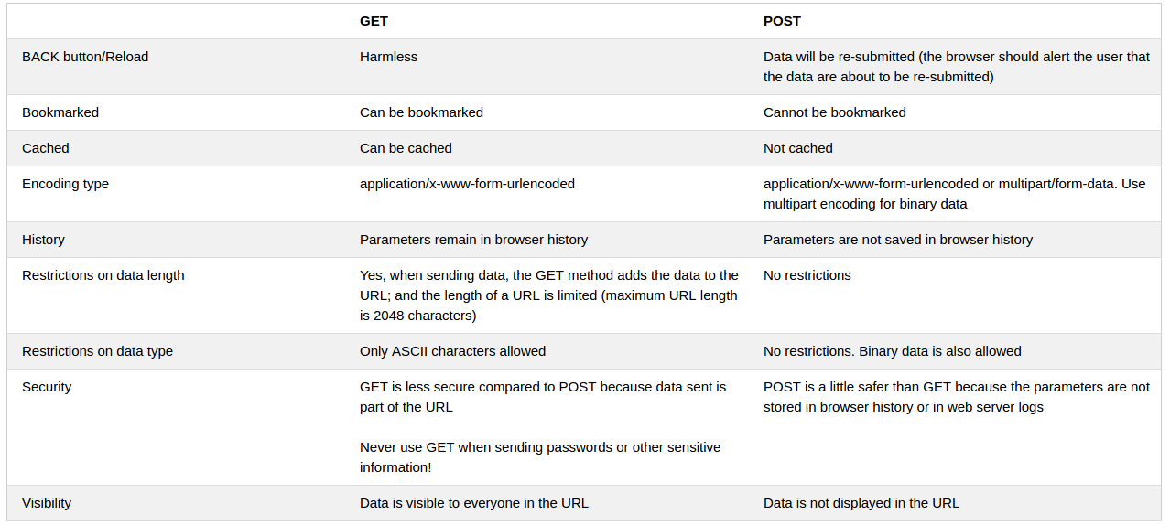
get vs post
From http://www.w3schools.com/tags/ref_httpmethods.asp

Slide 44
Activity
Add server-side code to save the result to a file, instead of just writing to console

Slide 45
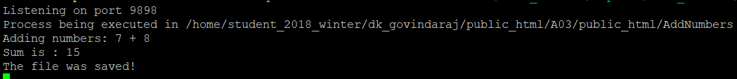
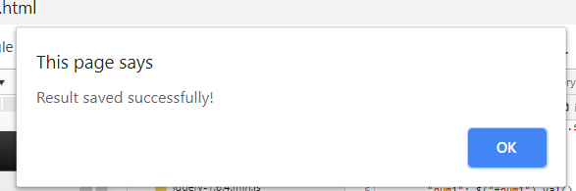
//include file system, needed to write a file
var fs = require('fs');
const FILE_NAME = "result.txt";
app.post('/addNumbers', function (request, response) {
// ……the same code as before………..
//now write the result of the addition to the file
//add \n at the end of the file
fs.writeFile("./" + FILE_NAME, sum + "\n", function (err) {
if (err) {
return console.log(err);
}//end if
console.log("The file was saved!");
//if succeeded, send it back to the calling thread
return response.send(200, (num1 + num2));
});
});

Slide 46
fs.writeFile()
fs.writeFile(file_name, stringified_data, function (err) {
if (err) {
//code when error
}
else {
//code when succeeded
}//end if
return response.send(200, data_to_be_sent_back);
});

Slide 47
Activity
Now, add code to read data from the file, and then displays on the client side

Slide 48
Cont’d…
//client side
function getResult() {
//now sends request
$.post(SERVER_URL + "/getResult",
function (data) {
alert("Result received successfully!" + data);
$('#result').html(data);//write to the element
}).fail(function (error) {
alert("Error: " +error.responseText);
});
}

Slide 49
// Server side
app.post('/getResult', function (request, response) {
console.log("Opening " + FILE_NAME);
var content;
// First I want to read the file
fs.readFile('./' + FILE_NAME, function (err, data) {
if (err) {
return console.log(err);
}
//encode to a string
content = data.toString('utf8');
console.log(content);//just for debugging purposes
//if succeeded, send it back to the calling thread
return response.send(200, content);
});

Slide 50
Activity
Final modification: append the results to a file instead of writing over!

Slide 51
Cont’d…
app.post('/addNumbers', function (request, response) {
//read the file first
var content;
fs.readFile('./' + FILE_NAME, function (err, data) {
if (err) {
return console.log(err);
}
//encode to a string
content = data.toString('utf8');
console.log(content);

Slide 52
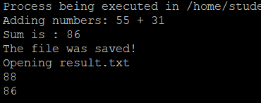
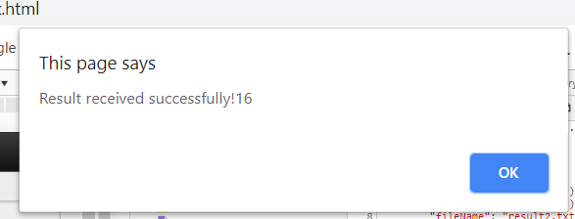
var num1 = parseFloat(request.body.num1);
var num2 = parseFloat(request.body.num2);
console.log('Adding numbers: ' + num1 + " + " + num2);
var sum = num1 + num2;
//now append the result of the addition to the file
//add \n at the end of the file
fs.writeFile("./" + FILE_NAME, content + sum + "\n", function (err) {
if (err) {
return console.log(err);
}//end if
console.log("The file was saved!");
//if succeeded, send it back to the calling thread
return response.send(200, (num1 + num2));
});
});
});

Slide 53
Activity
Modify the local storage version of the University DB app to read from and write to a file on the server!
Write your server-side scripts based on the code used in the exercises!

Slide 54
Investigate the starter files
<div data-role="content">
<label for="name">Name:</label>
<input type='text' name='name' id='name'>
<label for="address">Address:</label>
<input type='text' name='address' id='address'>
<label for="phone">Phone:</label>
<input type="text" name='phone' id='phone'>
<br>
<button onclick="saveInformation();">Save</button>
<button onclick="deleteInformation();">Delete</button>
<br><br>
<label for="search">Search:</label>
<input type="text" name='search' id='search'>
<button onclick="searchInfo();">Search</button>
<br>
<button onclick="displayRecords();">Display records</button>
<br>
<table id="displayTable">
</table>
<br><br>
</div>
<div data-role = footer data-id="persistent" data-position="fixed">
<h1>Developed by Dinesh.</h1>
</div>

Slide 55
StoreUniversity.js – Client Side
function saveInfo () {
if (validateData()) {
//create an object
var newObj = {
"Name": $("#name").val(),
"Address": $("#address").val(),
"PhoneNumber": $("#phone").val()
};
/**
* Implement the rest
*
* 1) "post" the data (newObj) to the server
* (the data should be saved by your server-side script
* 2) If error, alert the user
*
*/
}//end if validateData()
}//end function

Slide 56
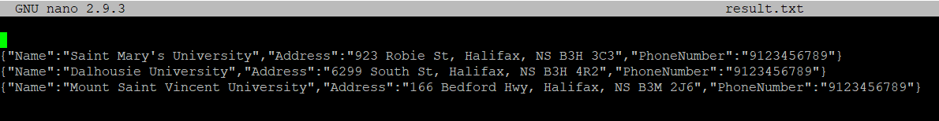
university-app-server.js
app.post('/saveUniversity', function (request, response) {
console.log("saveUniversity being executed in " + __dirname);
console.log(request.body);
/*
* Implement the rest!
*
* Extract the data from request.body and saves it to a file.
*
*/
});

Slide 57
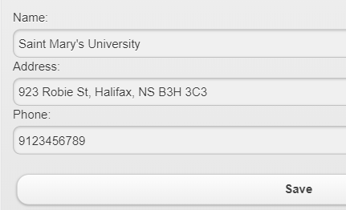
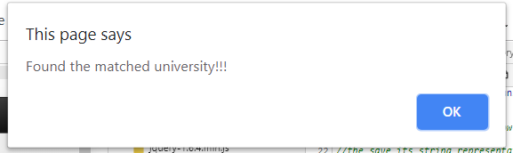
StoreUniversity.js
function searchInfo () {
//first grab the name of the university
var key = $('#searchKey').val();
/**
* Implement the rest
*
* 1) "post" the key to the server
* 2) Obtain the returned university object
* 3) Extract the attribute values
* 4) Fill the corresponding input fields
* 5) Alert any errors to the user.
*/
}//end function

Slide 58
university-app-server.js
app.post('/getUniversity', function (request, response) {
console.log("getUniversity being executed in " + __dirname);
console.log(request.body);
/**
* Implement the rest!
*
* Extract the search key from request.body, searches for the university
* object, and returns it if found.
*
*
*/
});

Slide 59
StoreUniversity.js
function deleteInformation () {
//first grab the name of the university
var key = $('#searchKey').val();
/**
* Implement the rest
*
* 1) "post" the key to the server
* 2) Get the returned university object (deleted object)
* 3) Tell the user if the deletion succeeded
* 4) Alert any errors to the user.
*/
}//end function

Slide 60
university-app-server.js
app.post('/deleteUniversity', function (request, response) {
console.log("deleteUniversity being executed in " + __dirname);
console.log(request.body);
/**
* Implement the rest!
*
*
* Extract the search key from request.body, searches for the university
* object, and deletes it if found.
*
*
*/
});

Slide 61
StoreUniversity.js
$('#displayButton').click(
function () {
var universities = [];//place holder
/**
* Implement the rest
*
* 1) request the server to return the university object "array"
* 2) If the array is empty display proper message
* 3) Alert any errors to the user.
*/
}//end function
);

Slide 62
university-app-server.js
app.post('/getAllUniversities', function (request, response) {
console.log("getAllUniversities being executed in " + __dirname);
/**
* Implement the rest!
*
* Reads the university object array and returns it (if not empty).
*
*
*/
});

